Slide 1

Capstone project
On
Western Countries Financial Data
By
Kishan Kumar

Slide 2
Index
Project Summary 2
Dataset Overview 4
Data Cleaning & Insights 6
Statistical Analysis Using Excel 12
Make database on SQL Server & run queries 14
Data Import from SQL Server to PowerBI 21
PowerBI Dashboard 23
Conclusion and Inferences 25

Slide 3
Project Summary
Analyze Western Countries Financial Data that is a product sales data
Perform data cleaning and statistics analysis
Perform some Graphical Analysis and Drive insights using Excel
Insert dataset into SQL server by making a database
Import the Data from the SQL Database into PowerBI
Make a Detailed Interactive Dashboard by using visualization tool PowerBI
Derive Conclusion and Inferences from the Dashboard

Slide 4
Dataset Overview
I have provided a Sales data of different bicycle brand
Western Countries Financial Data is product sales data of year 2013 and 2014.
Dataset include 16 columns and 701 rows.
Dimension fields are segment, country, product, discount band, month name, year, date, month number.
Measure fields are unit sold, manufacturing, sales price, gross sales, discount, sales, COGS, profit.

Slide 5
Dataset Overview
Segment- government, channel partners, midmarket, enterprise, small business.
Country- Canada, France, Germany, United States of America, Mexico.
Product- Carretere, Montana, Paseo, Velo, VVT, Amarilla.

Slide 6
Data Cleanning & Insights
Data cleaned by removing currency sign from the measure field of western countries financial data.
Perform some formatting and highlighted fields to
Graphical Analysis on the Data using Excel
Given data is in excel format so visualize data In MS Excel office
Created pivot table and pivot chart to drive insights as below.

Slide 7
Chart represent about relation between sales of product in
different segments.
Government segment sales are highest among all almost 52million
Channel Partners and Midmarket have almost similar lower sales.

Slide 8
Graph represent about relation between sales and products.
Product Paseo have highest sales almost 32 million where
Carretera have lowest sales almost 14 million sales.

Slide 9
Graph represent relation between profit in segment and country.
Government segment have highest profit among all segment.
All countries have highest profit in government segment and lower profit in Enterprise segment
France and Germany have higher profit more than 25 million in government segment.

Slide 10
Graph show that sales in different countries
America and Canada have almost similar sales in which America sales is highest sales 25 million among all.
Mexico have lowest sales almost 21million sales.

Slide 11
Chart show about yearly sales of various products in different-2 segment countries.
Sales reached higher point in year 2014 almost 92 million sales where sales in 2013 reached to 26 million.

Slide 12
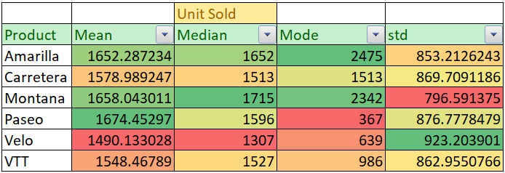
Statistical Analysis Using Excel
Statistical Analysis on basis of Product's Unit Sold-

Slide 13
Mean for overall item sold is almost same. Although best mean is of product Paseo with Avg. 1674 shown in green cell and product Velo have the least mean 1490 shown by red color formatting.
Median is almost same as mean but with little bit variation.
Mode vary very much across product. Amarilla, Carretera, and Montana shown in green cell and yellow cell are bought in high quantity at one time. But for Paseo(Most sold) is bought in very less quantity at a time. produt Velo and VTT remain between the both above.

Slide 14
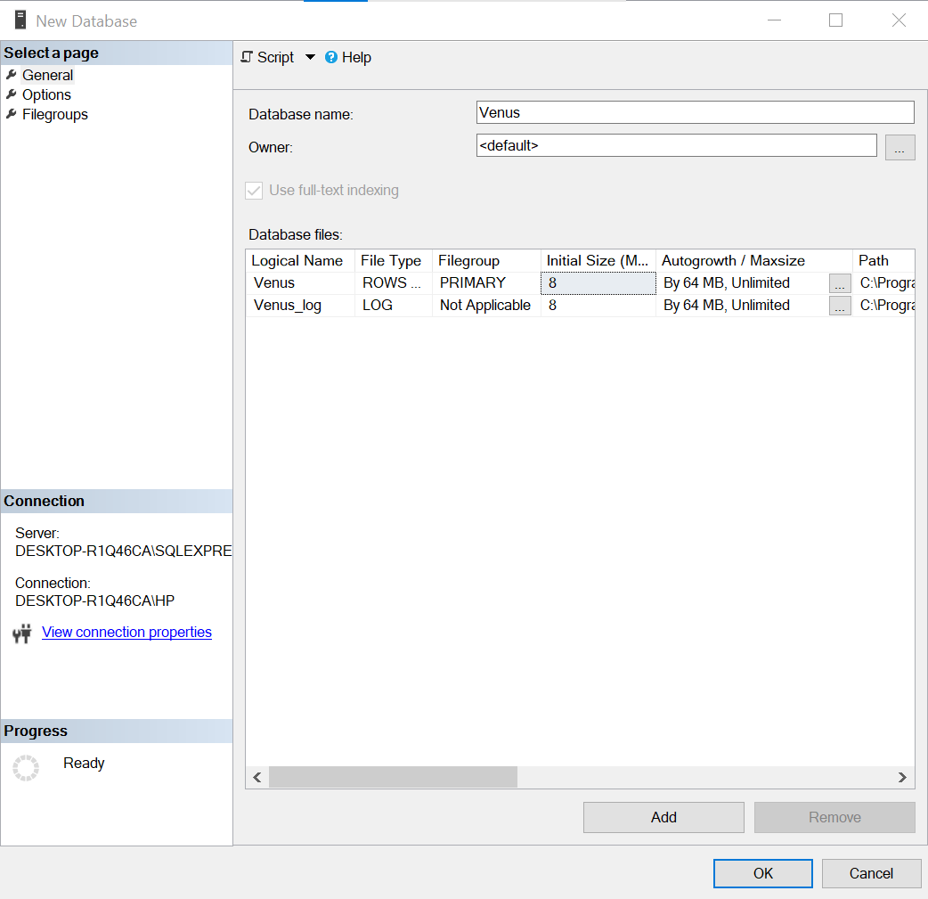
Database on SQL Server
Created a Database Venus

Slide 15
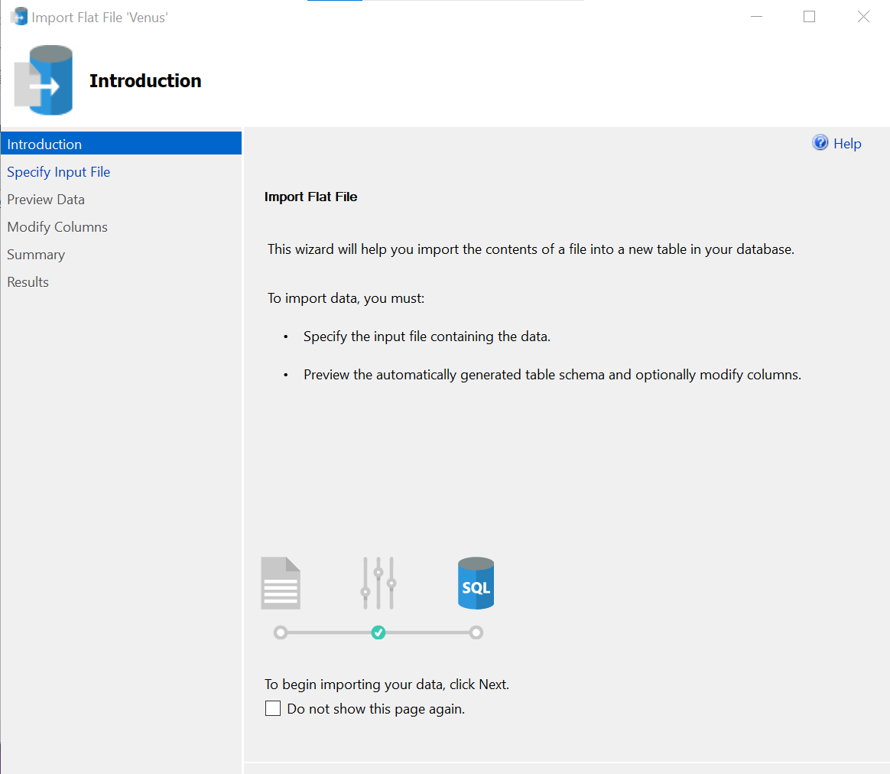
Database on SQL Server
Inserted Dataset Western Countries Financial Data
as westerndata into SQL Server

Slide 16
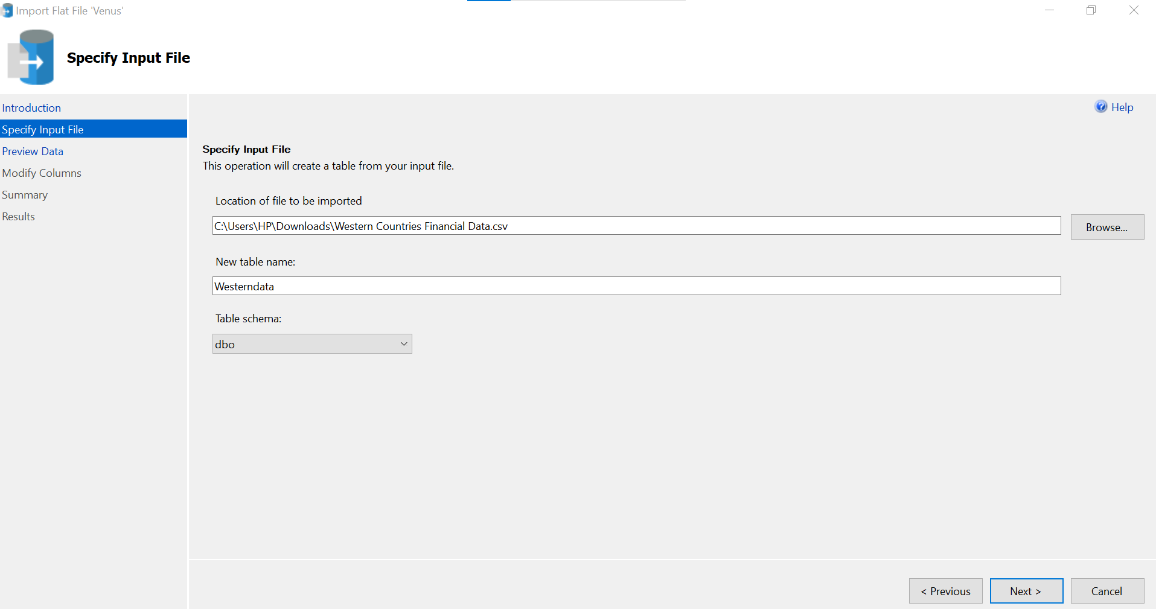

Slide 17
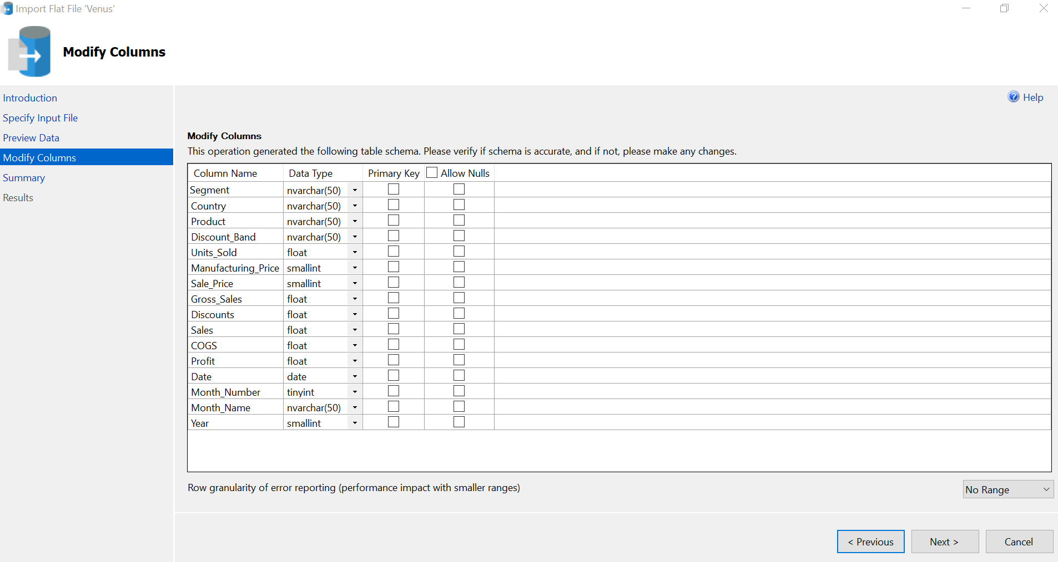

Slide 18
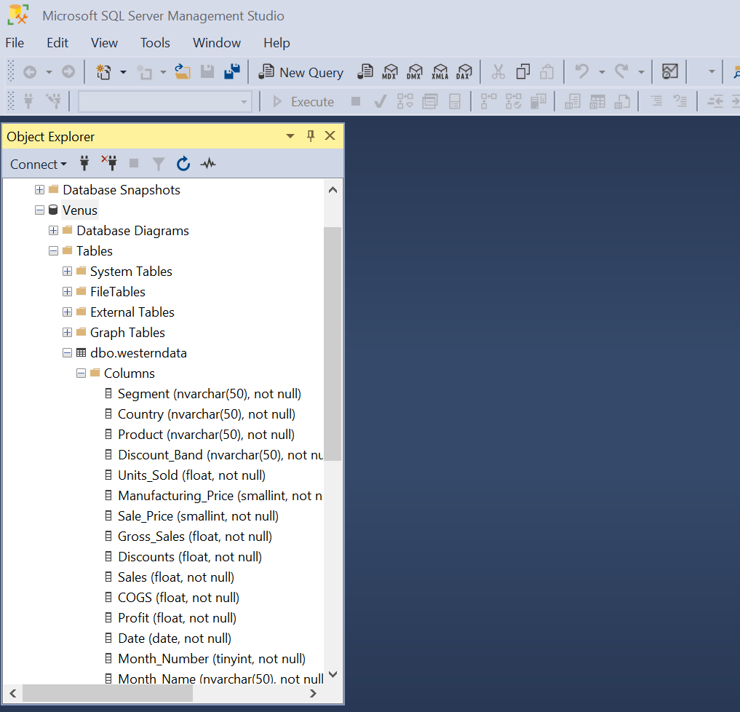

Slide 19
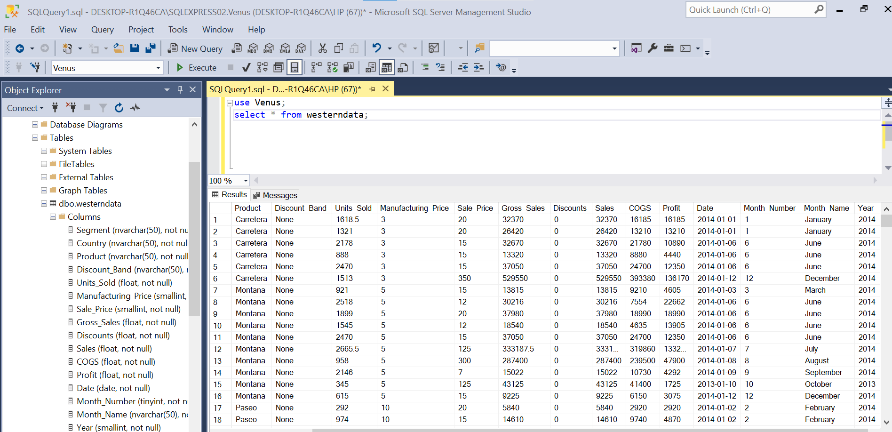
Running some query- on Table westerndata
Query – select * from westerndata;

Slide 20
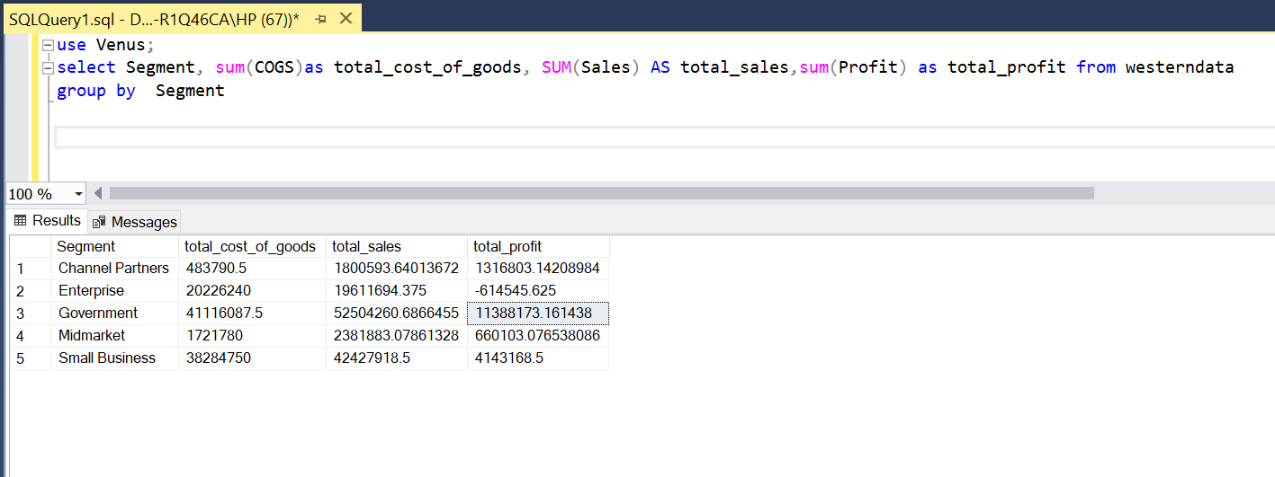
Used Query – select segment, sum(COGS) as tatal_cost_of_goods, sum(sales) as total_sales, sum(profit)as total_profit from westerndata;

Slide 21
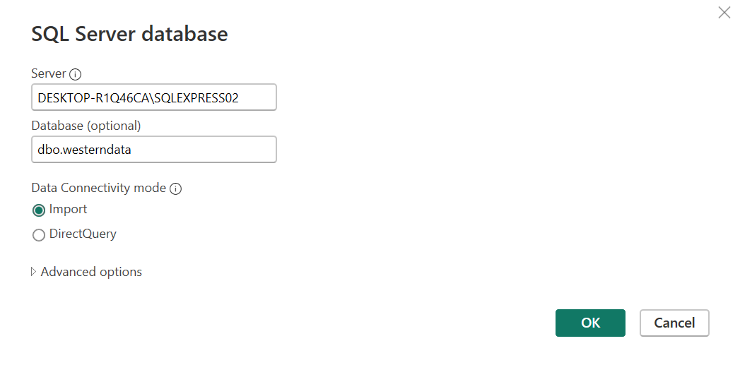
Data Import from SQL Server to PowerBI

Slide 22
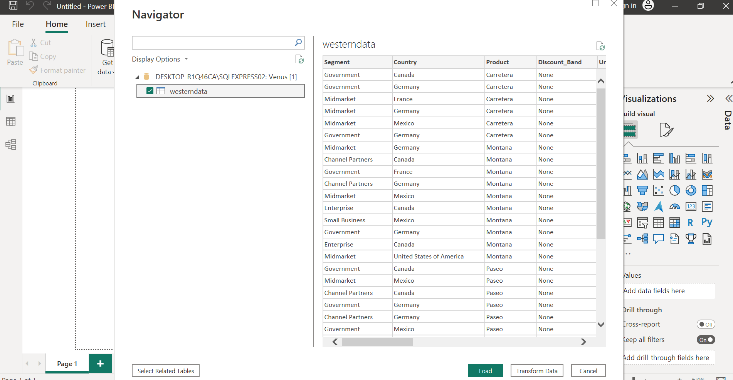

Slide 23
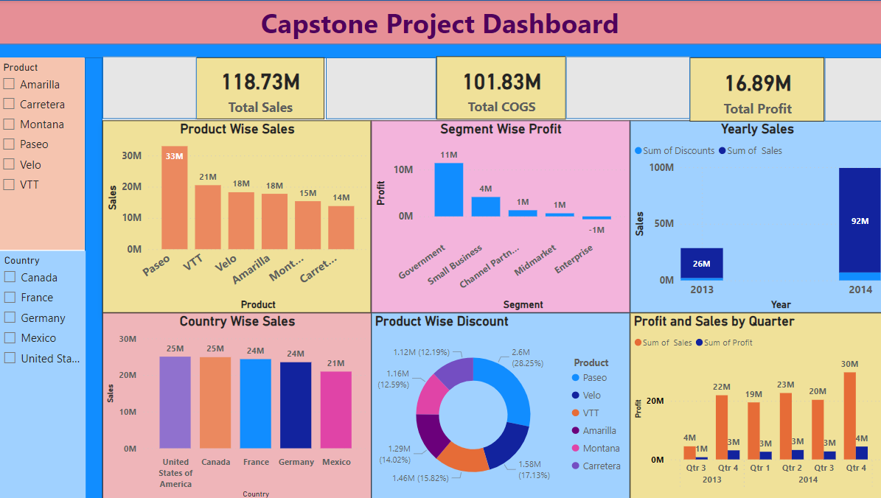
Powerbi dashboard

Slide 24
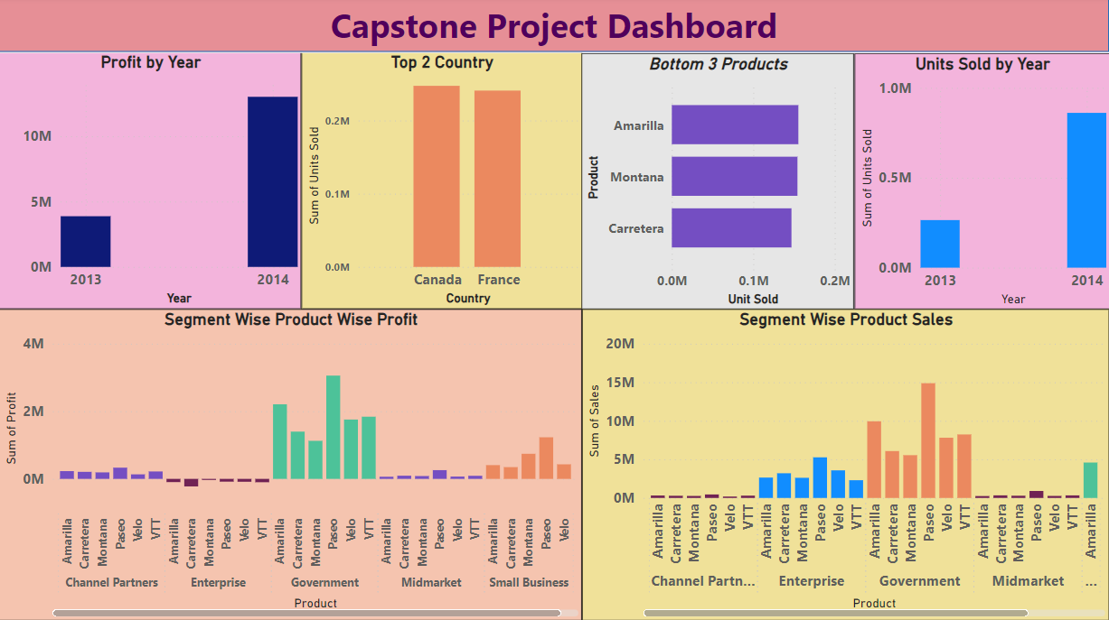
Powerbi dashboard

Slide 25
Conclusion and Inferences
Project is about analyzing sales dataset. I have done following steps and concluded with some insights
Data save as CSV
Import to SQL Server
Save data as SQL database
Run few Queries
Import SQL database to PowerBI
Visualization report

Slide 26
Total Sales- 118.73m
Total Profit- 16.89m
Total COGS – 101.83m
Profit is just 14.2% of total sales where COGS is 85.55% of total sales.
Government segments have highest revenue as well as sales among all segments.
Product Paseo have highest sales almost 33m where product Carretera show lower sales almost 14m.
Product Paseo have highest discount 28.25% among all
Sales increased in 2014 reached 92m than in 2013 where sales are 26m.
There has been an steep increase in sales and profit in every quarter.(Here in Q3 of 2013, we have data of only 1 month hence it should be ignore in coparison)
Top 2 countries are Canada and France
Bottom 3 products are Amrilla, Montana, Carretera

Slide 27
THANK YOU

